Slide 1
State Transition Diagram

Slide 2
Introduction
An object’s state and behaviour can be affected by:
Changes to attribute values
Results of operations
Changes of links with other objects
Internal events
External events

Slide 3
Three models
Object model:
Static structure of objects in a system and their relationships.
Contains class diagrams.
dynamic model;
describes aspects that change over time: state transition diagrams
functional model;
Use Case diagrams

Slide 4
State Diagrams
State diagrams are used to describe the behavior of a system.
State diagrams describe all of the possible states of an object as events occur.
Each diagram usually represents objects of a single class and track the different states of its objects through the system.

Slide 5
When to Use: State Diagrams
Use state diagrams to demonstrate the behavior of an object through many use cases of the system.
Only use state diagrams for classes where it is necessary to understand the behavior of the object through the entire system.
Not all classes will require a state diagram and state diagrams are not useful for describing the collaboration of all objects in a use case.
State diagrams are other combined with other diagrams such as interaction diagrams and activity diagrams
.

Slide 6
Components
Initial state
Event
Transition
State
Final state.

Slide 7
Events
Something that happens at a point in time
Mouse button clicked / Signal changes
Logically ordered events - causally related
Concurrent events - causally unrelated
do not effect each other
there is no order between them
1-way transmission of information from one object to another

Slide 8
Characterisations of a state
State: Alarm ringing
Description: alarm on watch is ringing to indicate target time
Event sequence that produces the state:
set alarm (target time)
current time = target time

Slide 9
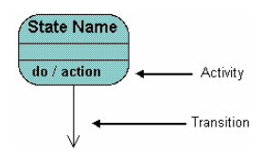
How to Draw: State Diagrams
State diagrams have very few elements.
The basic elements are rounded boxes representing the state of the object and arrows indicting the transition to the next state.
The activity section of the state symbol depicts what activities the object will be doing while it is in that state.

Slide 10
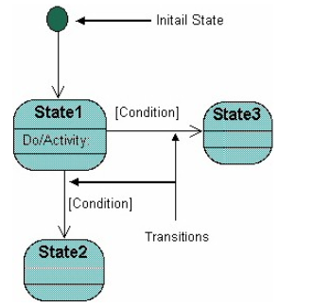
Contd…
All state diagrams being with an initial state of the object.
This is the state of the object when it is created.
After the initial state the object begins changing states. Conditions based on the activities can determine what the next state the object transitions to

Slide 11
When the object enters the Checking state it performs the activity "check items."
After the activity is completed the object transitions to the next state based on the conditions [all items available] or [an item is not available].
If an item is not available the order is canceled. If all items are available then the order is dispatched.
When the object transitions to the Dispatching state the activity "initiate delivery" is performed. After this activity is complete the object transitions again to the Delivered state.

Slide 12
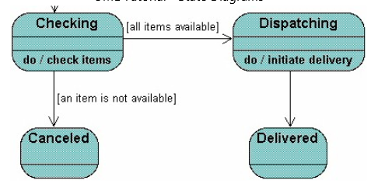

Slide 13
State diagrams can also show a super-state for the object.
A super-state is used when many transitions lead to the a certain state.
Instead of showing all of the transitions from each state to the redundant state a super-state can be used to show that all of the states inside of the super- state can transition to the redundant state.
This helps make the state diagram easier to read

Slide 14
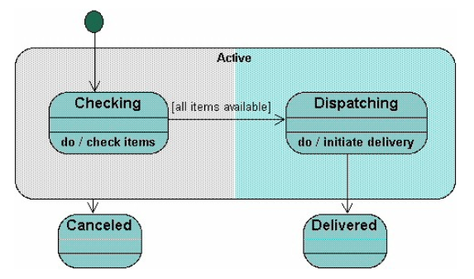

Slide 15
Both the Checking and Dispatching states can transition into the Canceled state, so a transition is shown from a super-state named Active to the state Cancel.
By contrast, the state Dispatching can only transition to the Delivered state, so we show an arrow only from the Dispatching state to the Delivered state.

Slide 16
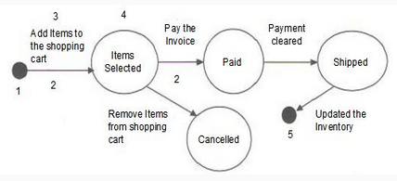
Online shopping cart state transition diagram

